Slide 1
Advanced methods of
molecular dynamics
Monte Carlo methods
Free energy calculations
Ab initio molecular dynamics
Quantum molecular dynamics
Trajectory analysis

Slide 2
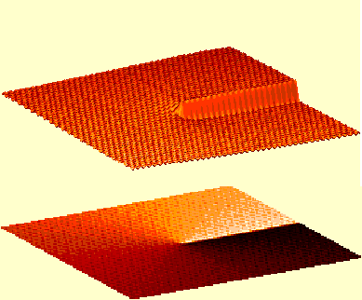
1. Monte Carlo methods
Direct MC: hit & miss method
Importance sampling: The Metropolis method
Isobaric MC
Grand canonical MC
Kinetic MC

Slide 3
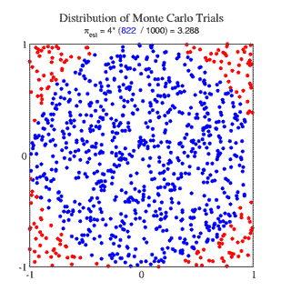
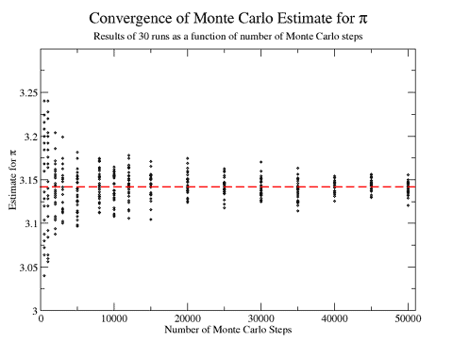

Direct MC
Normal integration methods (e.g., Simpson) impractical
in many dimensions. Instead, Monte Carlo:
Hit & miss method for estimating multidimensional
integrals F = ∫ f(x) dx.
No inherent konwledge of f(x).
Good when f(x) positively (or negatively) definite.
Bad for oscillatory functions.
π = 4 N_{hit}/N_{total}

Slide 4
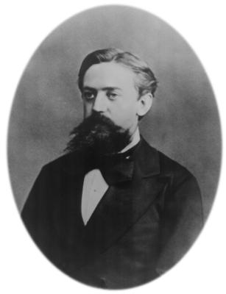
Importance Sampling
Random numbers chosen from a specific distribution ρ(x) such that the function is evaluated in regions which make important contributions.
Generating a Markov chain of states (functional values)
f₁, f₂, f₃, … which has a limiting distribution ρ(x). In a Markov
chain f_{n} depends only on f_{n-1}.
f_{n} linked to f_{n-1} by a transition probability p_{n-1,n}
Microscopic reversibility:
f_{n} p_{n,n-1} = f_{n-1} p_{n-1,n}
A. A. Markov
(1856 - 1922)

Slide 5
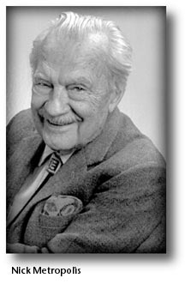
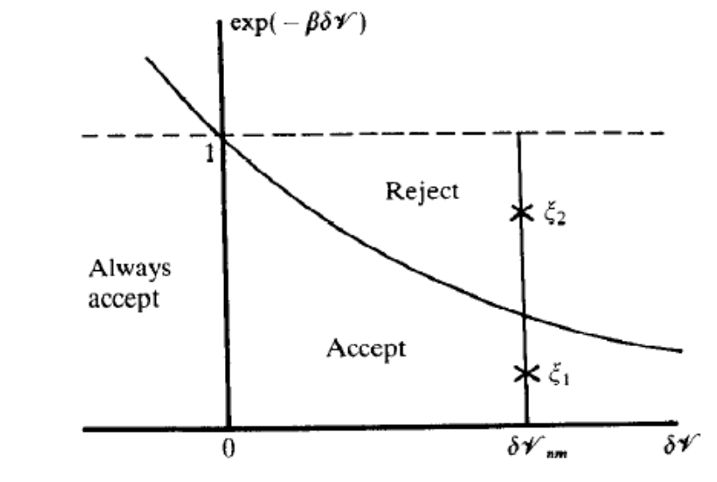
Metropolis method
From state with energy E_{n-1} to state with
energy E_{n} by randomly displacing a particle
(or several particles, or all of them):
If E_{n} < E_{n-1} … accept
If E_{n} > E_{n-1} … generate a random number R,
0 < R < 1,
if R < exp(-(E_{n}-E_{n-1})/kT) …accept
if R > exp(-(E_{n}-E_{n-1})/kT) …reject
(1915 - 1999)
Ideal acceptance ratio ~50%:
too small – too high rejection rate, no move;
too large - too small steps, little move.
Generates canonical ensemble with limiting distribution: exp(-E/kT)

Slide 6
Advantages/Disadvantages of MC
+ Simple; no need to evaluate forces,
+ Directly samples the (canonical) statistical ensamble;
no need to invoke the ergodic theorem,
Does not explicitely contain the time variable;
principally impossible to evaluate time-dependent (equilibrium) properties such as correlation functions,
- For complex potentials Monte Carlo sampling can often
be less efficient than that of molecular dynamics.

Slide 7
Isobaric Monte Carlo
NpT is the usual experimental ensemble:
Additional factor in the partition function
Z_{p} = ∫₀∞ dV V^{N} exp (-pV/kT)
Modified Metropolis method:
From state with energy E_{n-1} to state with energy E_{n} by
randomly displacing particles and changing the volume
(or lnV).
Changing volume means displacing all particles &
changing long range corrections (Ewald).
Generates canonical ensemble with
limiting distribution:
exp(-(E+pV)/kT+NlnV)

Slide 8
Grand Canonical Monte Carlo
Fixed temperature T, volume V, and chemical potential μ,
i.e., the free energy of inserting a particle.
Additional factor in the partition function:
Z_{μ} = Σ₀∞ (N!)⁻¹ V^{N}/Λ³ x exp(-Nμ/kT), … Λ: thermal wavelength
Modified Metropolis method:
From state with energy E_{n-1} to state with energy E_{n} by
randomly displacing particles and changing the number of particles by +/-1.
Generates canonical ensemble with limiting distribution:
exp(-(E-Nμ)/kT-lnN!-3NlnΛ+NlnV)!

Slide 9
Grand Canonical Monte Carlo II
Implementations
Simple-minded method method:
Randomly switching particles from “existing“ to “ghost“ by changing ocupancy numbers (1 or 0). Then applying Metropolis method (ghost atom moves always accepted).
More sophisticated algorithms:
Different types of moves: (i) a particle is displaced, (ii) a particle is destroyed (no record kept), and (iii) a particle is created at
a random position. Micorscopic reversibility by making the creation and destruction probabilities equal. Problems with high rejection rates (unfavorable overlaps when particle is created).

Slide 10
Grand Canonical Monte Carlo III
Problems:
In dense systems (fluids) it is hard to create a new particle without drastically increasing energy -> large rejection rate
(special algorithms looking for cavites).
Practical implementation – Widom insertion method:
μ = -kT ln(Q_{N}/Q_{N+1})
μ = μ_{ideal gas} + μ_{excess}
μ_{excess} = -kT ln ∫ds^{N+1} <exp(-(E(s^{N+1})-E(s^{N}))/kT)>_{N}
- conventional NVT Monte Carlo with N particles,
- frequent random insertions of an extra particle,
- evaluation of exp(-(E(s_{N+1})-E(s_{N}))/kT) & averaging

Slide 11
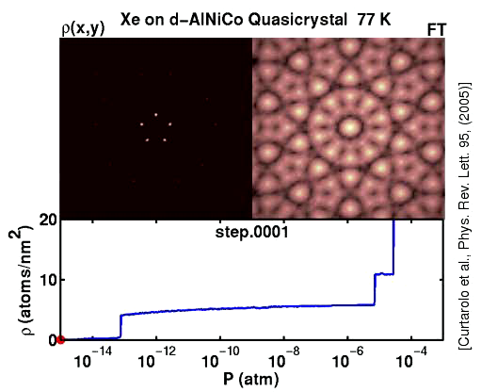
Grand Canonical Monte Carlo IV
Movie

Slide 12
Kinetic Monte Carlo
Allows to simulate time evolution. However, not at the molecular
level but by introducing reaction rates (which have to be known
from elsewhere, e.g., from transition state theory).
At each step, system can jump from state A into one of the ending states B_{i}.
survival probability: p_{survival}(t) = exp (-k_{tot} t), ktot = Σk_{ABi}
integrated probability of escape between 0 and t: 1 – p_{survival}(t)
Repeated many times – Markovian process, i.e., system looses memory before doing the next step.
Most often used for surface diffusion or growth.

Slide 13
Kinetic Monte Carlo Procedure
A stochastic algorithm propagating the system A -> B -> C…
System is in state A,
For each path using known escape probability p_{ABi} we generate a random transition time t_{Bi}
We choose a path with shortest transition time t_{Bmin}
We proceed to the next step.
Advantages: detailed balance preserved,
long (second) times accessible.
Problems: system can visit states which were not intuitively expected and for which rate constant is not given,
small barriers question valididty of the Markov chain and shorten the accesible time scale.

